Slide 1
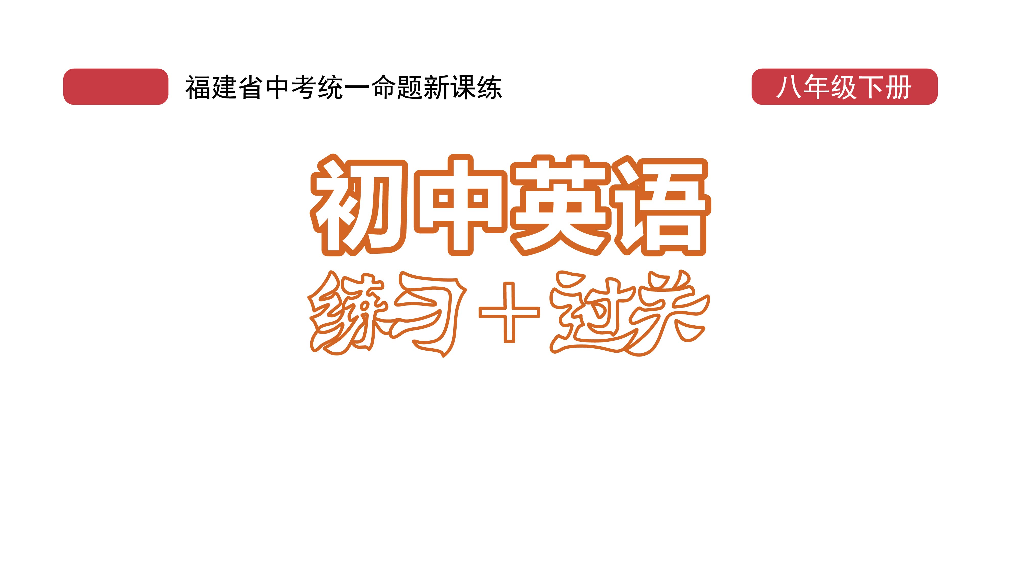
课时练习
模块八 第三章 第四节

Slide 2
一、翻译下列词组。
1. 曾经； 一度________________
2. 在过去________________
3. 一间服装厂 ______________________
4. 日本传统服装 ______________________________
at one time
in the past
a clothing factory
Japanese traditional clothing

Slide 3
二、用括号内所给单词的适当形式填空， 每空不限词数。
1. Today in Japan, kites are often flown as part of a ___________(celebrate).
2. At lunchtime, there’s a _______(choose) between the buffet(自助餐) and the set menu.
3. Mary told me she _________ (watch) a shadow puppet performance(皮影戏) last night.
celebration
choice
watched

Slide 4
二、用括号内所给单词的适当形式填空， 每空不限词数。
4. China _________ (be) working hard on poverty alleviation(脱贫) and it succeeded.
5. Either Alipay or WeChat _______ (help) provide travelers with a health code(健康码).
6. Kate said that she ______________ (live) with her parents in England at that time.
was
helps
was living/lived

Slide 5
二、用括号内所给单词的适当形式填空， 每空不限词数。
7. I want to know when Qi Baishi ________ (finish) the famous painting Lotus in Fall.
8. The weather report said there _________ (be) sunny intervals(间隔) and showers tomorrow.
9. The cook added some milk and __________ (mix) all the ingredients together in a bowl.
finished
would be
mixed

Slide 6
二、用括号内所给单词的适当形式填空， 每空不限词数。
10. —I don’t know if he___________(come) tomorrow.
—He will come if it ______________(not rain).
will come
doesn’t rain

Slide 7
三、单项选择。
( )1. —What did Lucy ask just now?
—She asked _____________.
A. if there will be a meeting
B. if we are having a meeting
C. when the meeting would begin
C

Slide 8
三、单项选择。
( )2. —When are you leaving for Xiamen?
—______this Friday ______ this Sunday.
A. Either; or
B. Both; and
C. Not only; but also
A

Slide 9
三、单项选择。
( )3. __________, March was the first month in the Roman(罗马的) calendar.
A. At any time B. At one time C. At times
B

Slide 10
三、单项选择。
( )4. I know nothing about the man who saved me, _______that he is a shop owner.
A. except B. or C. and
A

Slide 11
三、单项选择。
( )5. __________, people always paid the bills in cash (现金). But now more and more people pay with mobile phones.
A. At present B. In the future C. In the past
C

Slide 12
四、将下列句子合并成含有宾语从句的复合句。
1. Li Hua said … He will go for a picnic this Sunday. ____________________________________________
2. Do you know …? When does the train leave?
____________________________________________
3. What do you think of the pants? The woman asked me.
____________________________________________
Li Hua said he would go for a picnic this Sunday.
Do you know when the train leaves?
The woman asked me what I thought of the pants.

Slide 13
四、将下列句子合并成含有宾语从句的复合句。
4. Mr. Black told us … The moon goes around the earth. ____________________________________________
5. I want to know … Is his sister a model?
____________________________________________
Mr. Black told us the moon goes around the earth.
I want to know if/whether his sister is a model.

Slide 14


